Slide 1
Mapping Designs to Code
Code example: Hemish Kapadia

Slide 2
Mapping Designs to Code
Process: Write source code for
  Class and interface definitions
  Method definitions

Slide 3
Design Class Diagrams
DCDs contain class or interface names, superclasses, method signatures, and simple attributes.
These are sufficient for basic class definitions.
Elaborate from associations to add reference attributes.

Slide 4
Reference Attributes
Reference Attributes are suggested by associations and navigability in a class diagram.
Note that reference attributes may be implied rather than explicit on a class diagram. You may have to ask “How is this association accomplished.”
Example: A product specification reference on a Sales Line Item.

Slide 5
Role Names
Each end of an association is a role. Reference Attributes are often suggested by role names.
Product
Specification
SalesLineItem
Described-by
productSpec
Description
productSpec

Slide 6
Interaction Diagrams
Interaction Diagrams and Operation Contracts are used to specify methods.
They give most of the details for what the method does. It is usually best to have a Subject Matter Expert available to answer questions about implementation details.

Slide 7
Containers and Collections
Where an object must maintain visibility to a group of other objects, such as a group of Sales Line Items in a Sale, object-oriented languages often use an intermediate container or collection.
These will be suggested by a multiplicity value greater than one on a class diagram.

Slide 8
Constructors
Ask how classes come into existence.
Do you need methods in other classes to create them?
Example: A sale can create sales line items, and will need a method to do so.

Slide 9
Coupling drives code
Ideally, least-coupled classes will be created first and most coupled classes last. That way, you can describe the reference attributes as you go instead of going back to revise the class definitions later.
Obviously, a class cannot have a major dependency on a class that will be implemented in a later iteration.

Slide 10
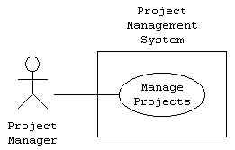
Working Example: PM
Notes:
User model
Project Manager communicates with the Manage Projects use case, or who uses the functionality of the system to manage projects.

Slide 11
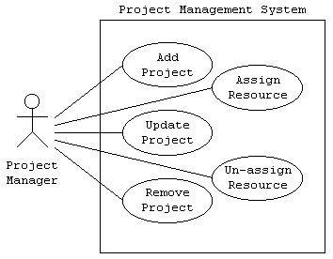
PM: Use Case Diagram
Notes:
Manage Projects use case by detailing the functions a Project Manager expects of the system: add project, remove project, update project, assign resource, and un-assign resource.

Slide 12
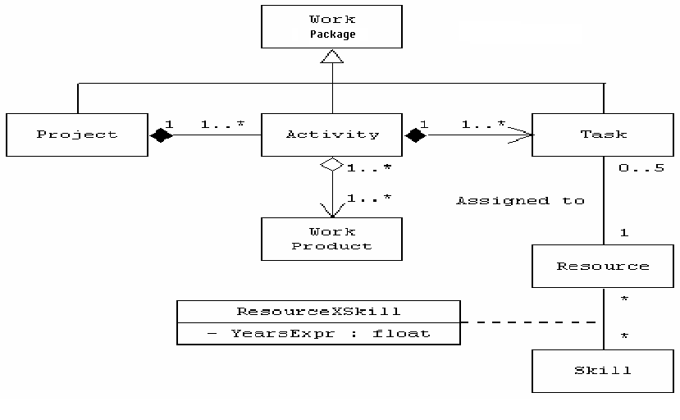
PM: Class Diagram
Notes:
A project is composed of one or more activities, and an activity is part of a single project. Given a project, we can access its associated activities, and given an activity, we can access its associated project. The composition association, depicted as a filled diamond, indicates that the part (activity) cannot out-live the whole (project).
An activity is composed of one or more tasks, and a task may be a part of a single activity. Given an activity, we can access its associated tasks, but given a task, we cannot access its associated activity. Navigability, depicted as an arrow, indicates the supported access path (from an activity to its tasks).
Projects, activities, and tasks are all types of work effort, thus, they inherit the characteristics from the Work Effort class. Generalization (inheritance) is depicted using a hollow triangle pointing at the more general class.
An activity contains one or more work products (documents, etc.), and a work product may be a part of one or more activities. The aggregation association, depicted as a hollow diamond, indicates that the part (work product) can out-live the whole (activity).
A task is associated with one resource (person), and a single resource may be associated with up to five tasks; that is, a person may be assigned up to five tasks.
A resource has multiple skills, and multiple resources may have the same skill. When a resource has a particular skill, we maintain the years of experience the resource has with the associated skill. A class, attached to the association by a dashed line, indicates an association class that maintains characteristics including attributes and operations for the association.

Slide 13
PM: Class to Code
class WorkPackage;
class Project;
class Activity;
class Task;
class WorkProduct;
class Resource;
class Skill;
class ResourceXSkill;

Slide 14
PM: Class to Code
class WorkPackage
{ // Details omitted };
class Project : public WorkPackage
{ private: CollectionByVal<Activity> theActivity; };
class Activity : public WorkPackage
{ private: Project *theProject;
CollectionByVal<Task> theTask; CollectionByRef<WorkProduct>
theWorkProduct; };

Slide 15
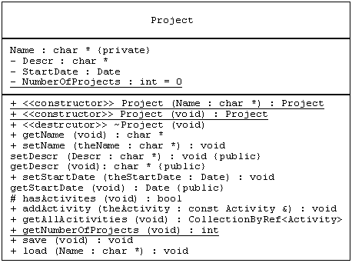
PM: DCD Mapping
Notes:
The compartment below the name represents the attributes of the class (name, description, start date, and the number of projects), and the compartment below that represents the operations of the class (constructors, destructor, assessor-operations, load, and save). Notice how the constructors and destructor are identified using the stereotype keyword enclosed in double angle brackets (constructor or destructor), and how visibility is specified using a + symbol for public visibility: - symbol for private visibility, and # symbol for protected visibility. The visibility may also be indicated using a property string after the attribute or operation in curly braces. Also notice, how class-scope (static) attributes and operations are underlined.

Slide 16
PM: DCD Code
class Project
{ private:
char *Name;
char *Descr;
Date StartDate;
static int NumberOfProjects;
public:
Project (char *Name);
Project (void); ~Project (void);
char *getName (void);
void setName (char *theName);
void setDescr (char *Descr);
char *getDescr (void);
void setStartDate (Date
theStartDate);
Date getStartDate (void);
void addActivity (const Activity &theActivity);
CollectionByRef<Activity> getAllAcitivities (void);
static int getNumberOfProjects (void);
void save (void);
void load (char *Name);
protected:
bool hasActivities (void); };
int Project::NumberOfProjects = 0;

Slide 17
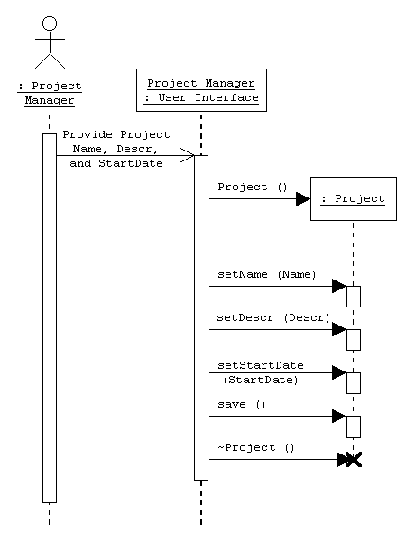
PM: Sequence Diagram

Slide 18
PM: Sequence to Main
void main (void)
{ char *Name; char *Descr;
Date StartDate; Project aProject;
// provide project Name, descr, and startdate
aProject.setName (Name);
aProject.setDescr (Descr);
aProject.setStartDate (StartDate);
aProject.save (); }

Slide 19
Text reference
Note that sample Java code for the POS case study is given in the text on Pages 377 to 380 and for the Monopoly case study on pages 380 to 384.
It is suggested that class members review that code and understand how the specification resulted in the code.

Slide 20
Other References
http://www.martinig.ch/mt/index.html
http://www.sparxsystems.com.au/UML_Tutorial.htm
http://archive.devx.com/free/mgznarch/vcdj/1999/jun99/uml1.asp

